Slide 1
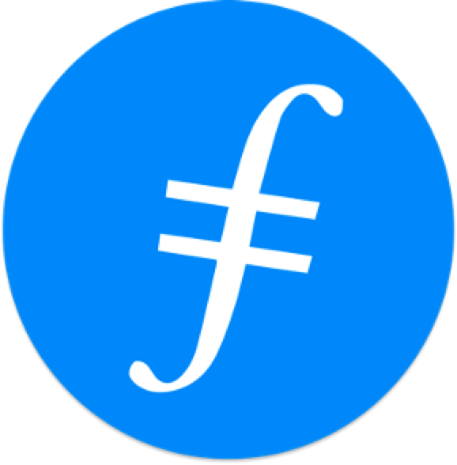



Chapter 2:
Byzantine Generals Problem
Beginners Guide to Filecoin
Content created by Brown Zhang
Researcher @ KEN Labs

Slide 2
Byzantine Generals Problem explained
The Byzantine generals problem is a game theory problem that describes:
How difficult it is for dispersed parties to reach a consensus without the help of a trusted central party.
How can members of a network agree on a specific reality when no one can verify the identities of other members.

Slide 3
The research paper
"The Byzantine Generals Problem," a research article by Leslie Lamport, Robert Shostak and Marshall Pease, was published in 1982.
Although the Byzantine generals problem had been studied in computer science before 1982, this was one of the first attempts to translate it into parallel and proposed solutions.
To address the problem of the Byzantine generals, loyal generals need a safe means to agree on a plan (known as consensus) and carry it out (known as coordination).
However, this issue affects all types of computer systems, not only those used in military applications.

Slide 4
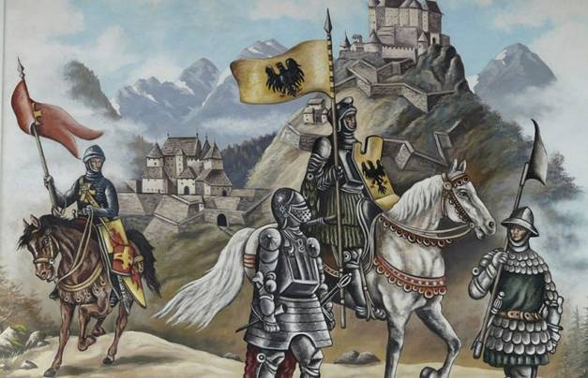

Slide 5
Byzantine fault tolerance (BFT)
In every distributed computer system, Byzantine failures are virtually unavoidable.
There are several reasons why a distributed computer system could fail:
a software defect,
a hardware malfunction,
or a malicious attack when applied to real-world computer systems.
Byzantine fault tolerance is the ability to defend against these conditions.
Networks that can endure more Byzantine failures are said to have a higher tolerance, implying that they are more secure than those that can't.

Slide 6
Byzantine generals problem in a distributed system
Only decentralized systems are susceptible to the Byzantine generals problem, as they lack a dependable source of information and have no way of confirming the information they get from other network users.
In centralized systems, an authority is trusted to disseminate accurate information while preventing the spread of erroneous or fraudulent information across the network.

Slide 7
Blockchain: The solution for the Byzantine general problem
A blockchain creates a layer that can be trusted without needing to trust every individual. This is accomplished by a network of nodes coming together to agree on the truth before it is recorded.
If the general is unsure about the substance of the communication, the other generals can verify it using what they know to be true.
Once one node has recorded it, a copy is sent to all other nodes in the network, making the information redundant. The PoW consensus algorithm is designed to achieve this goal.

Slide 8
How does Bitcoin solve the Byzantine generals problem?
Bitcoin needs the means to handle ownership and avoid double-spending as a monetary system.
Bitcoin employs a blockchain, or a public, distributed ledger, that stores a history of all transactions to accomplish this in a trustless manner.
The blockchain, in the Byzantine generals analogy, is the truth that all parties must agree on.
If all the nodes in the Bitcoin network could agree on which transactions happened when and in what order, they could verify Bitcoin ownership and create a working, trustless monetary system without the need for centralized authority.

Slide 9
Proof-of-Work (PoW) and the Byzantine generals problem
Miners validate blocks and compete with other miners to solve cryptographic puzzles to produce blocks as part of a PoW consensus method. This work comes at a high cost to the creator, incentivizing them to share accurate information.
By employing a proof-of-work consensus mechanism, Bitcoin overcame the Byzantine generals problem and established a clear, objective rulebook for the blockchain.
There can be no disagreement or tampering with the information on the Bitcoin network because the rules are objective. The system for selecting who can mint new Bitcoin and the laws regulating which transactions are valid or invalid are both objectives.

Slide 10
Conclusion
For blockchains, solving the Byzantine Generals Problem means reaching network consensus in spite of many bad actors trying to steal from you, as well as the potential for various parts of the network to be down or malfunction.
Managing this task even for a short period of time is challenging, but achieving such a feat perpetually is a much more difficult undertaking.

Slide 11

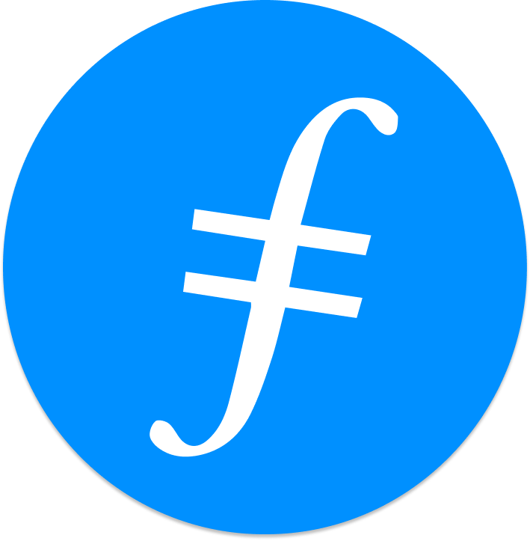
Feedback is welcomed.
https://github.com/kenlabs/Beginners-Guide-to-Filecoin

